Slide 1

Working With Data DATA9910
Week 11
Lucas Rizzo
email: lucas.rizzo@tudublin.ie
Notes:
Entered text
Slide 1: Introduction
Start with a brief introduction to the topic of image processing.
Mention that it's a crucial field in today's digital age.
Explain that you'll be covering the basics, real-world applications, and key terminology.
Slide 2: What is Image Processing?
Define image processing as the manipulation of an image to extract information or enhance its features.
Mention its wide range of applications, from photography to medical imaging.
Slide 3: Importance of Image Processing
Discuss the importance of image processing in various fields:
Medical: Diagnosis and treatment planning.
Entertainment: Special effects in movies and video games.
Security: Face recognition and surveillance.
Agriculture: Crop analysis and yield prediction.
Manufacturing: Quality control and defect detection.
Emphasize how it improves decision-making, saves time, and reduces errors.
Slide 4: Real-world Applications
4.1: Medical Imaging
Explain how image processing is used in medical imaging.
Mention applications like MRI, CT scans, and X-rays.
Highlight its role in disease detection and treatment planning.
4.2: Entertainment
Discuss how image processing enhances visual effects in movies and video games.
Mention CGI (Computer-Generated Imagery) and motion capture technology.
4.3: Security
Explain image processing's role in security through face recognition and surveillance systems.
Emphasize its significance in crime prevention and national security.
4.4: Agriculture
Discuss its applications in agriculture, such as crop analysis and yield prediction.
Explain how it helps farmers make informed decisions.
4.5: Manufacturing
Describe how image processing is used in manufacturing for quality control and defect detection.
Mention its role in ensuring product consistency.

Slide 2
Indicative schedule
Week 1 | Set up environment and R notebook
Week 2 | Review Python and practice
Week 3 | Review R Importing data with R
Week 4 | Intro SQL and aggregate queries
Week 5 | Databases and scripting languages (To be submitted)
Week 6 | Interpreting Data (summary statistics, data visualisation)
Week 7 | Review week
Week 8 | Data manipulation in R Pandas and Numpy
Week 9 | Data visualisation in Python Data processing (regular expressions)
Week 10 | Audio data (R and tuneR) (To be submitted)
Week 11 | Image data (Python and skimage) (To be submitted)
Week 12 | Time series (Python and Pandas)
Week 13 | Working on Assignment Assignment deadline

Slide 3
Overview
Image processing definition
Loading and displaying images
Image manipulation
Basic image analysis
Image filtering and segmentation

Slide 4
Digital Image Processing
The manipulation of digital images using various computer algorithms and techniques to modify, analyse or extract information from the images.

Slide 5
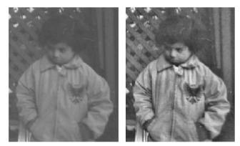
Digital Image Processing
The manipulation of digital images using various computer algorithms and techniques to modify, analyse or extract information from the images.
Fundamental field within computer vision and image analysis. It involves (not exclusively):
Enhancement techniques
Enhancing grayscale images with histogram equalization

Slide 6
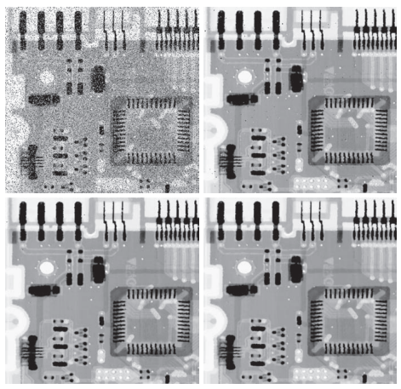
Digital Image Processing
The manipulation of digital images using various computer algorithms and techniques to modify, analyse or extract information from the images.
Fundamental field within computer vision and image analysis. It involves (not exclusively):
Enhancement techniques
Restoration techniques
Applying different filters to reduce noise

Slide 7
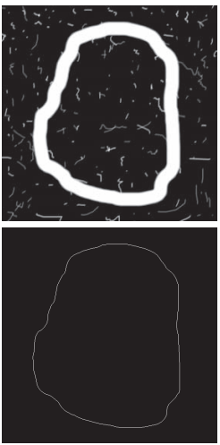

Digital Image Processing
The manipulation of digital images using various computer algorithms and techniques to modify, analyse or extract information from the images.
Fundamental field within computer vision and image analysis. It involves (not exclusively):
Enhancement techniques
Restoration techniques
Feature Extraction
Boundary extraction of a circular stroke

Slide 8
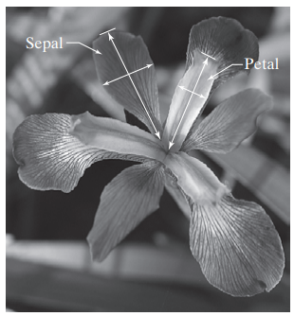
Digital Image Processing
The manipulation of digital images using various computer algorithms and techniques to modify, analyse or extract information from the images.
Fundamental field within computer vision and image analysis. It involves (not exclusively):
Enhancement techniques
Restoration techniques
Feature Extraction
Pattern Recognition
Petal and sepal width and length measurements performed on iris flowers for the purpose of data classification.

Slide 9
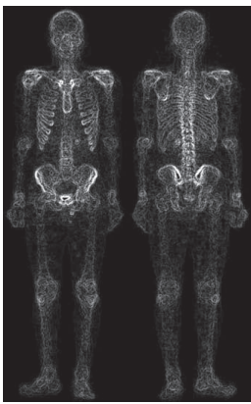
Digital Image Processing
The manipulation of digital images using various computer algorithms and techniques to modify, analyse or extract information from the images.
Fundamental field within computer vision and image analysis. It involves (not exclusively):
Enhancement techniques
Restoration techniques
Feature Extraction
Pattern Recognition
Medical Imaging
Medical imaging used to diagnose and analyze medical conditions. For example, with CT scans, MRI, and X-ray image processing aid in the detection of abnormalities.

Slide 10
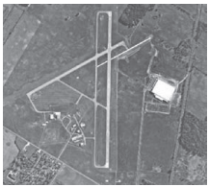
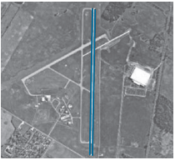
Digital Image Processing
The manipulation of digital images using various computer algorithms and techniques to modify, analyse or extract information from the images.
Fundamental field within computer vision and image analysis. It involves (not exclusively):
Enhancement techniques
Restoration techniques
Feature Extraction
Pattern Recognition
Medical Imaging
Remote Sensing
Aerial image of an airport and extracted two edges defining the principal runway

Slide 11
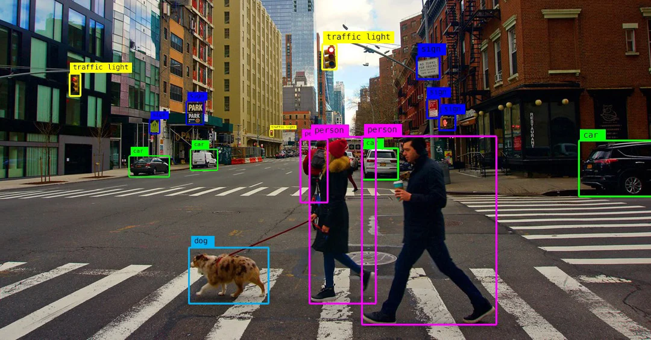
Digital Image Processing
The manipulation of digital images using various computer algorithms and techniques to modify, analyse or extract information from the images.
Fundamental field within computer vision and image analysis. It involves (not exclusively):
Enhancement techniques
Restoration techniques
Feature Extraction
Pattern Recognition
Medical Imaging
Remote Sensing
Computer Vision
etc.
Identify and analyze images so that computers can interpret them and perform actions

Slide 12
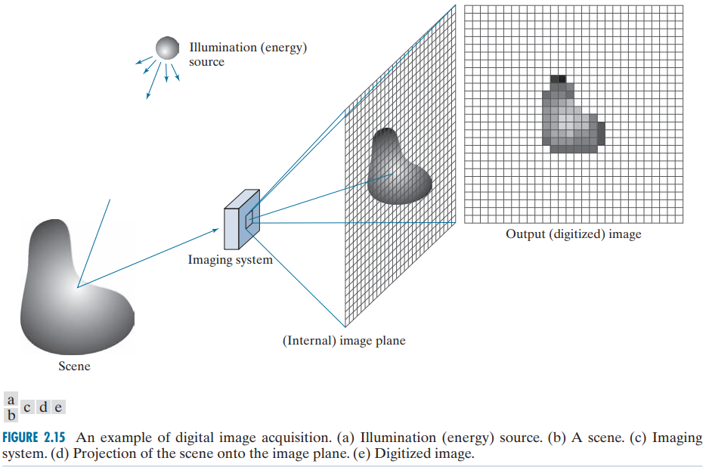
What is a digital image?

Slide 13
What is a digital image?
Two-dimensional representation of visual information that has been digitized

Slide 14
Image file types
There are several relevant image file formats, each with its own characteristics and use cases.
A more comprehensive list can be seen here
JPEG | Joint Photographic Experts Group file type. Reduces file size by discarding some image data, good for photographs and images with natural scenes.
PNG | Portable Network Graphics file type. Suitable for high-quality images with transparency such as icons and logos.
BMP | Bitmap Image file type. Uncompressed format resulting in high-quality images but large file sizes
TIFF | Tagged Image File Format. Flexible format supporting lossless compression, used in professional photography, medical imaging, and printing.
RAW | RAW formats are used in professional photography and are often uncompressed or minimally processed.

Slide 15
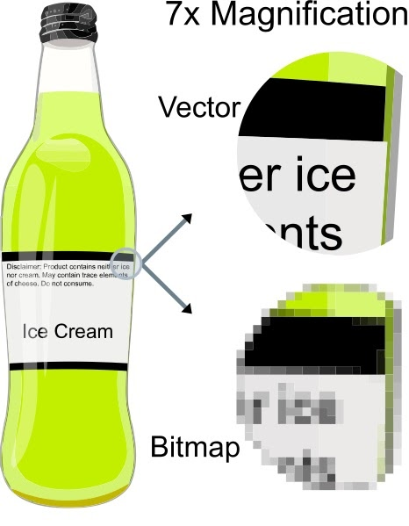
Vector image files
Common image types are usually pixel (or raster) images
Another popular type are vector images
They are constructed using proportional formulas rather than pixels
EPS, SVG and PDF are some examples
They are good for creating graphics that require frequent resizing

Slide 16

Vector images
An SVG file for example is defined using XML
<svg width="100" height="100" xmlns="http://www.w3.org/2000/svg">
<!-- Shapes and Elements -->
<circle cx="50" cy="50" r="30" fill="red" />
<rect x="10" y="10" width="40" height="40" fill="blue" />
<line x1="10" y1="60" x2="90" y2="60" stroke="green" stroke-width="5" />
<text x="20" y="90" font-family="Arial" font-size="12" fill="black">SVG Example</text>
</svg>

Slide 17
Vector images
Some Python libraries can handle some types of vector images, like SVG.
For example CairoSVG and PyCairo.
Most commonly though, you should use a vector graphics software to manipulate this
Examples include Adobe Illustrator, or languages for producing vector graphics, like in the TikZ package for Latex.
We are not going to study vector images in-depth.

Slide 18
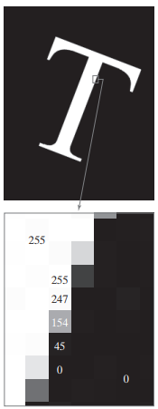
Digital image representation (Grayscale)
Discrete representation of images
A rectangular grid of pixels P(x,y)
Each pixel p will store an intensity value. Usually, aa 8 bit/pixel, which allows us to have (0-255) different brightness (gray) levels
0 → black;
255 → white;
in-between → gray
Image size m ✕ n → mn pixels
Represented as an array or matrix.

Slide 19
Task 1
Create a numpy array of 100x100 dimensions, with a random int value between 0 and 255 in each position. You will need to set the dtype value of the numpy array to np.uint8
Using the skimage.io module, call the io.imshow function passing your numpy array and see the resulting image.
Tips in the next slide…

Slide 20
Task 1
Create a numpy array of 100x100 dimensions, with a random int value between 0 and 255 in each position. You will need to set the dtype value of the numpy array to np.uint8
Using the skimage.io module, call the io.imshow function passing your numpy array and see the resulting image.
Hint: you can check io.imshow examples in the documentation and how to generate random numpy arrays here.
Solution in the next slide

Slide 21
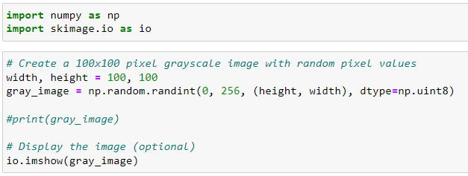
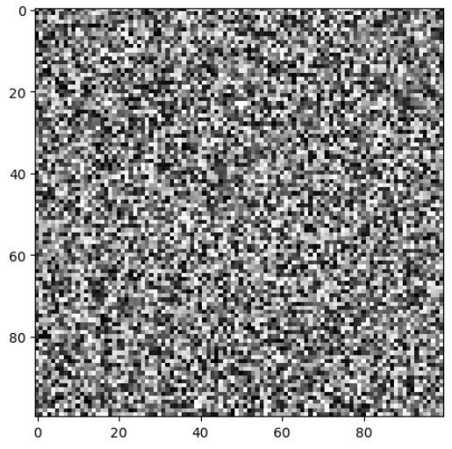
Task 1 (solution)

Slide 22
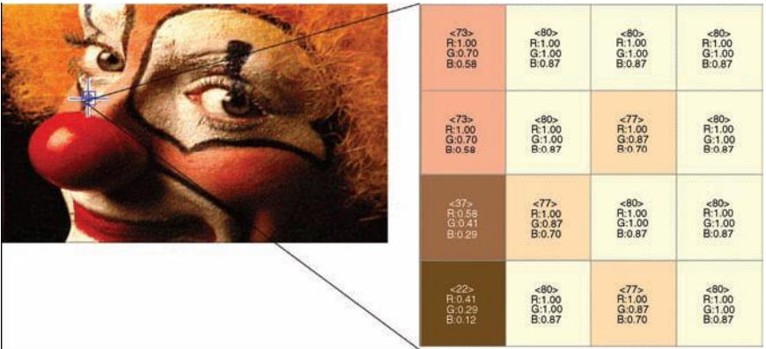
Image representation (RGB)
RGB images have three color channels represented using three 2D arrays of same size, one for each color channel: red (R), green (G), and blue (B)
Each array element contains an 8-bit value, indicating the amount of red, green, or blue at that point in a [0, 255] scale.
Three 8-bit values combine into a 24-bit number,
allowing 2^24 (16,777,216 color combinations)

Slide 23
Task 2
Using the same code from task 1, add a third dimension to your numpy array with length 3.
Display the resulting image with io.imshow function
Solution in the next slide

Slide 24
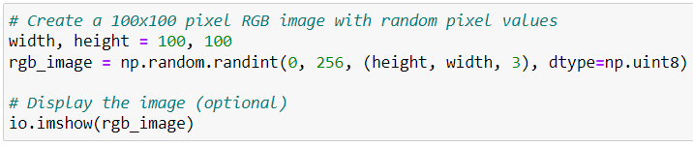
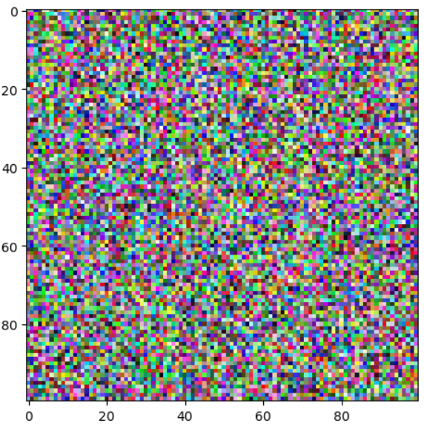
Task 2 (solution)

Slide 25
Loading and displaying images
In Python/R there a several toolkits that can help you loading an image.
In the context of data science and machine learning, the Skimage package is quite popular.
Specifically, the imread function to read images from files to your computer.

Slide 26
skimage.io.imread
The imread function gets a file path or url and returns a numpy array.
The dimension of the array will depend on the type the image:
If the image is in grayscale, then the output will be an M x N array (M rows and N columns).
If the image uses RGB colors, then the output will be M x N x 3.
If the image uses RGBA colors, then the output will be M x N x 4.
RGBA adds a fourth channel, to indicate opacity. This is a value between 0 and 1.

Slide 27
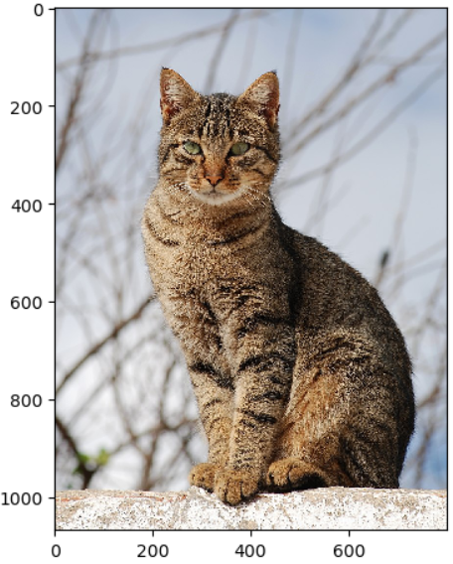
skimage.io.imread
Reading a local file
import skimage.io as io
image = io.imread('cat_example.jpg')
io.imshow(image)

Slide 28
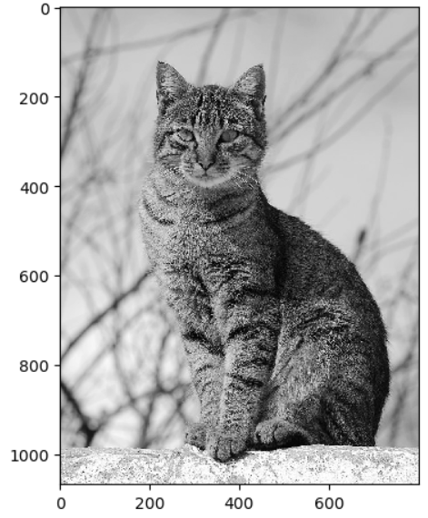
skimage.io.imread
Reading a local file in grayscale
import skimage.io as io
image = io.imread('cat_example.jpg', as_gray=True)
io.imshow(image)

Slide 29
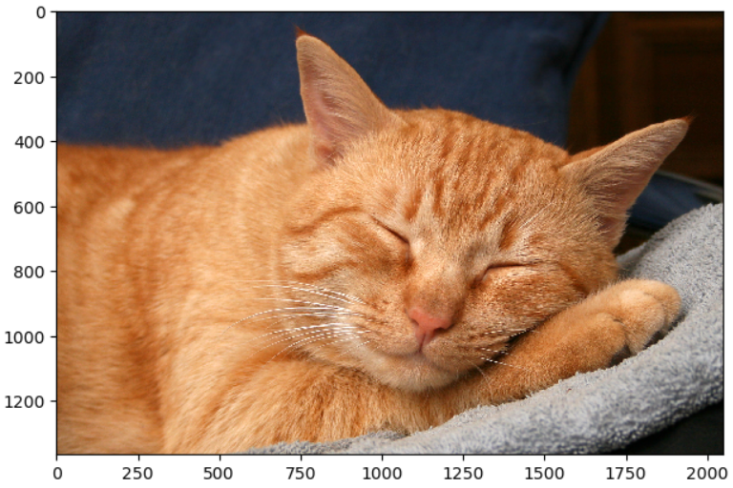
skimage.io.imread
Reading from a URL
import skimage.io as io
import matplotlib.pyplot as plt
image = io.imread('https://i.ibb.co/h041g0p/Red-Cat-8727.jpg')
plt.imshow(image)

Slide 30
Loading and displaying images
The Pillow module can also be used to load images.
One of its advantages is that it can also extract image metadata.
The metadata is often created by cameras and include technical information about an image and its capture method.
Metadata is usually stored in the Exchangeable image file format (Exif).

Slide 31
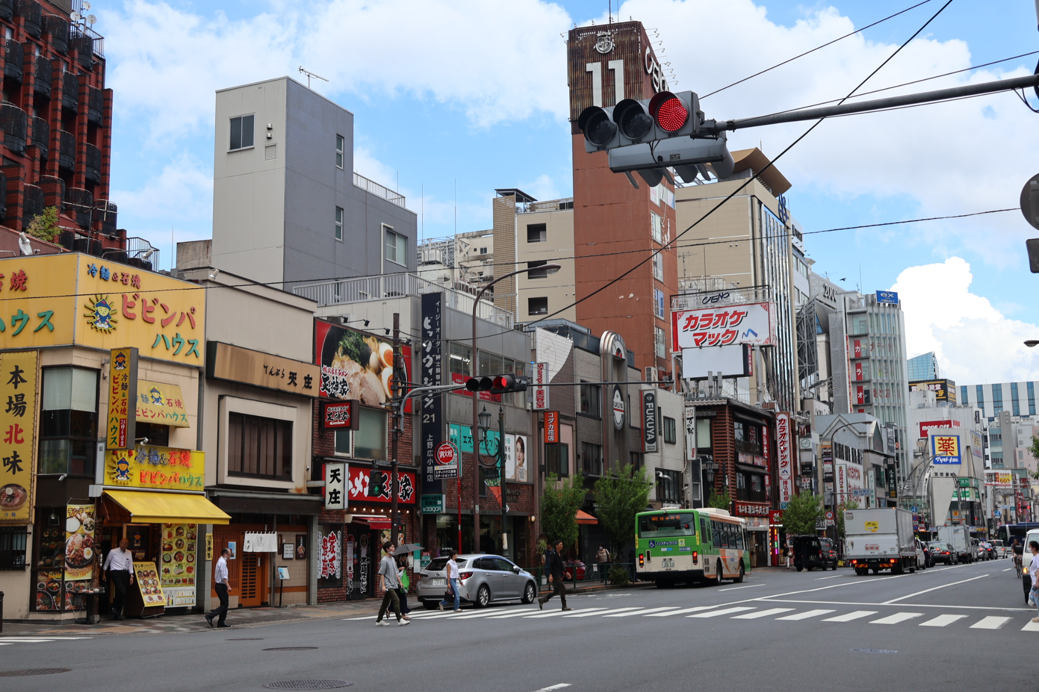
Example image metadata
from PIL import Image
from PIL.ExifTags import TAGS
# Open the image
image = Image.open("tokyo.jpg")
# Extracting the exif metadata
exifdata = image.getexif()

Slide 32
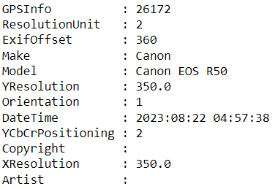
Example image metadata
# Looping through all the tags present
# in exifdata
for tagid in exifdata:
# getting the tag name instead of tag id
tagname = TAGS.get(tagid, tagid)
# passing the tagid to get its respective value
value = exifdata.get(tagid)
# printing the final result
print(f"{tagname:17}: {value}")
image.close()

Slide 33
Task 3
Run the above example and set the missing artist name (“Sarah”) in the image metadata. You can download the image here.
The tag id for artist name is 315 (you can also check the full list here). You should set that before printing all the other metadata information.
Hint: the getexif() function returns a dictionary like object.
Solution in the next slide

Slide 34
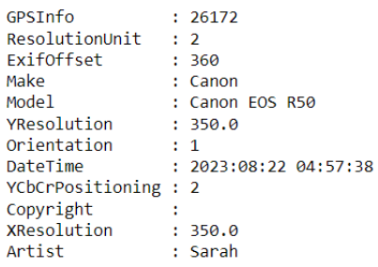
Task 3
from PIL import Image
from PIL.ExifTags import TAGS
# Open the image
image = Image.open("tokyo.jpg")
# Extracting the exif metadata
exifdata = image.getexif()
exifdata[315] = "Sarah"

Slide 35
Image manipulation
Manipulating images might be necessary when passing them to a machine learning model or to increase the diversity of training data.
We might need to:
Preprocess images: resizing all to the same size, reducing noise, normalizing pixel values
Extract features: edge detection, texture analysis
Data augmentation: resizing, cropping, rotating, and flipping training images to generate additional data.
Hence, image manipulation techniques can contribute to the quality and diversity of the training data

Slide 36
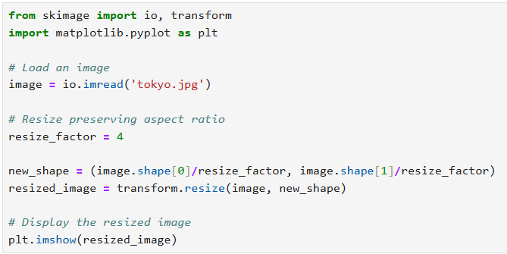
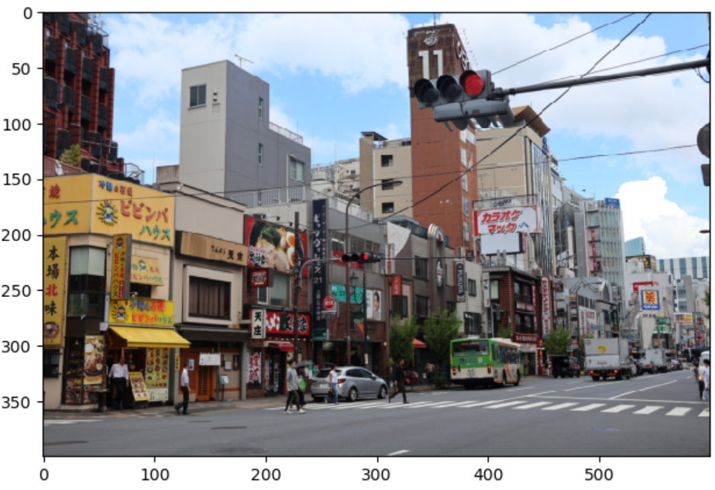
Basic Image Operations (resizing)

Slide 37
Task 4
Resize the previous image to 343 pixels width while preserving the its aspect ratio.
Solution in the next slide

Slide 38
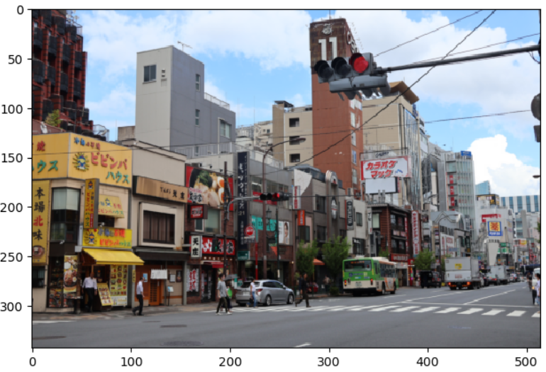
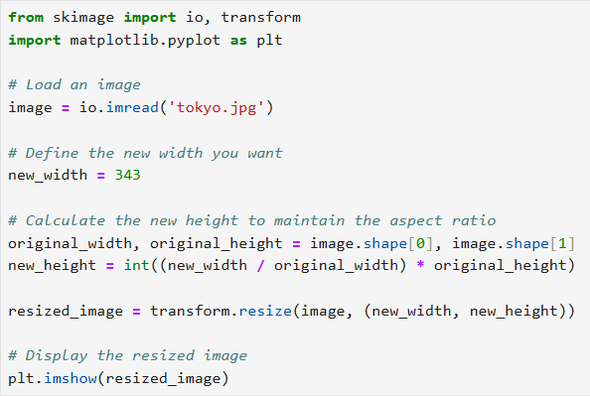
Task 4

Slide 39
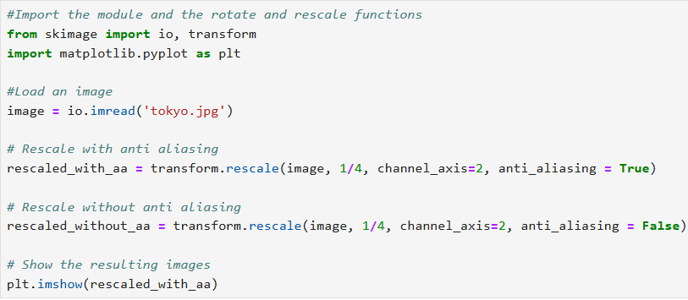
Basic Image Operations (resizing)
Another option to resize is to use the rescale function

Slide 40
Basic Image Operations (resizing)
Another option to resize is to use the rescale function
Rescale factor
Color channel, otherwise assumed to be grayscale
Option to smooth the image (more about that soon)

Slide 41
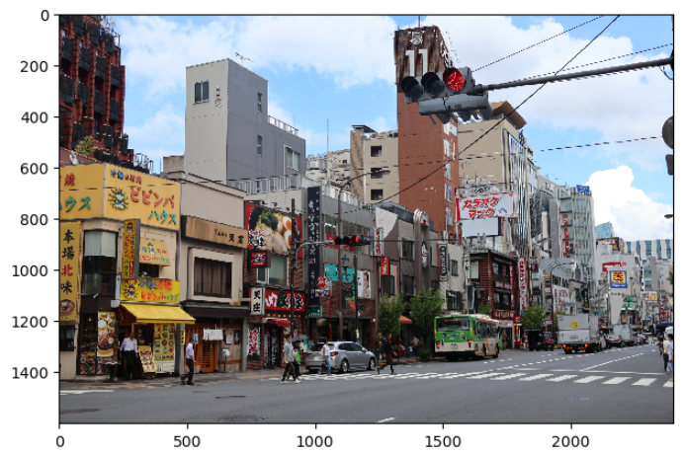
Basic Image Operations (cropping)
We can slice the numpy array to crop any area of the image
cropped_image = image[1150:1400, 1400:1800]
plt.imshow(cropped_image)

Slide 42
Basic Image Operations (cropping)
We can slice the numpy array to crop any area of the image
cropped_image = image[1150:1400, 1400:1800]
plt.imshow(cropped_image)
Which region of the image this will return?

Slide 43
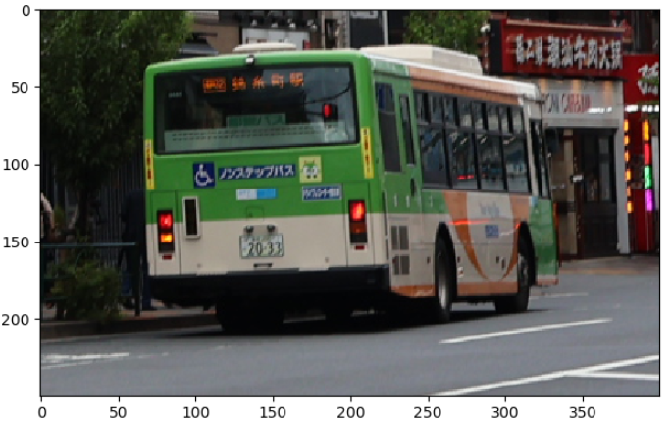
Basic Image Operations (cropping)
We can slice the numpy array to crop any area of the image
cropped_image = image[1150:1400, 1400:1800]
plt.imshow(cropped_image)
Y axis
X axis
The bus

Slide 44
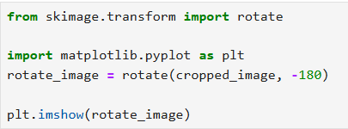
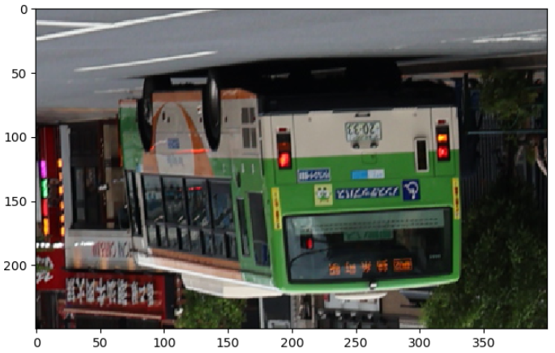
Basic Image Operations (rotating)
To rotate an image, scikit provides a rotate function

Slide 45
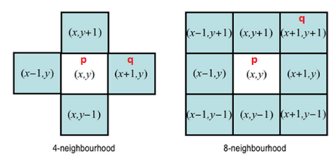
Image manipulation and enhancement
It is also possible to apply mathematical functions to filter, emphasise or remove certain features from an image.
Filters are usually a set of operations applied to the neighbours of each pixel.

Slide 46
Image Filtering and Convolution
For example, the Gaussian filter can be applied as a form of anti-aliasing.
This filter process an image in sections (neighbours).
It is aim is to smooth out aliasing artifacts, such as jagged or distorted edges, to create a more visually pleasing and accurate representation of the image

Slide 47
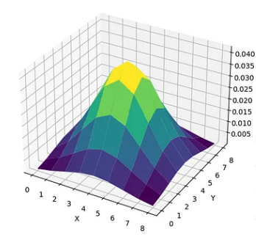
Gaussian filter
The Gaussian filter generates a new color value for each pixel by incorporating the color values of neighboring pixels, weighted depending on the distance between pixel and neighbor.
It is calculated by moving a sliding window over the image, adding up neighboring pixels (multiplied by weights).

Slide 48

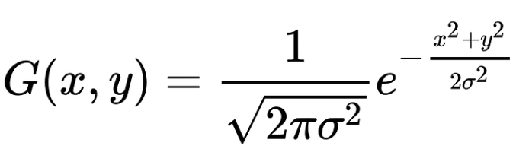
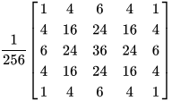
Gaussian filter
A gaussian filter (or kernel) of a specific size is defined, typically an odd-sized square matrix (3x3, 5x5, 7x7, etc.)
Approximated results
Gaussian function
Approximated results
Notes:
The center is [0, 0] and neighbours vary +-1. This is centered and makes sure the blur occurs evenly among the neighbours. Off center values would shift the result.

Slide 49
Gaussian filter
A gaussian filter (or kernel) of a specific size is defined, typically an odd-sized square matrix (3x3, 5x5, 7x7, etc.)
Approximated results
Gaussian function
The larger the kernel size, the stronger the smoothing effect, but it also increases computational complexity.
Approximated results

Slide 50
Gaussian filter
A gaussian filter (or kernel) of a specific size is defined, typically an odd-sized square matrix (3x3, 5x5, 7x7, etc.)
Approximated results
Gaussian function
Sigma controls the spread or width of the Gaussian distribution. A smaller sigma value means less smoothing, while a larger sigma value means more smoothing
Approximated results

Slide 51
Gaussian filter
Element-wise multiplication between the kernel and the corresponding neighborhood of pixels.

Slide 52
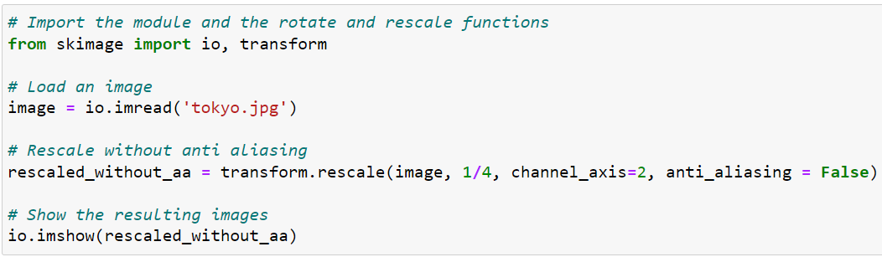
Task 5
a) Change the scale option below to 1/6.
b) Change the anti-aliasing option to true.
c) Compare the difference between results for the two parameters.

Slide 53
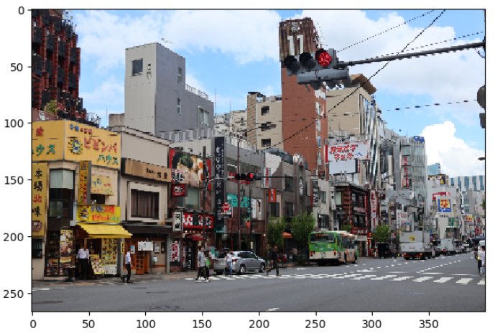
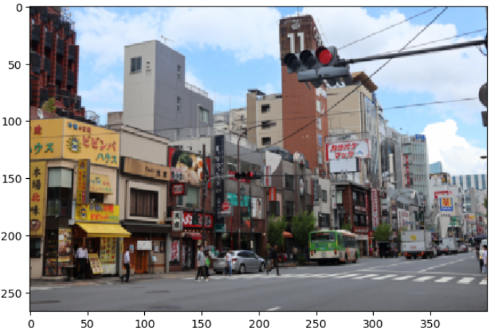
Task 5
Scale 1/6, no anti-aliasing
Scale 1/6, with anti-aliasing

Slide 54
Convolutional kernels
The process of applying a filter to an image is called convolution.
In the context of image processing, filters like the Gaussian one, are also known as convolution kernels: a small matrix or a grid of values used to process an image.
Kernels are a fundamental tool in many image processing and are used to extract features or enhance specific aspects of an image.

Slide 55
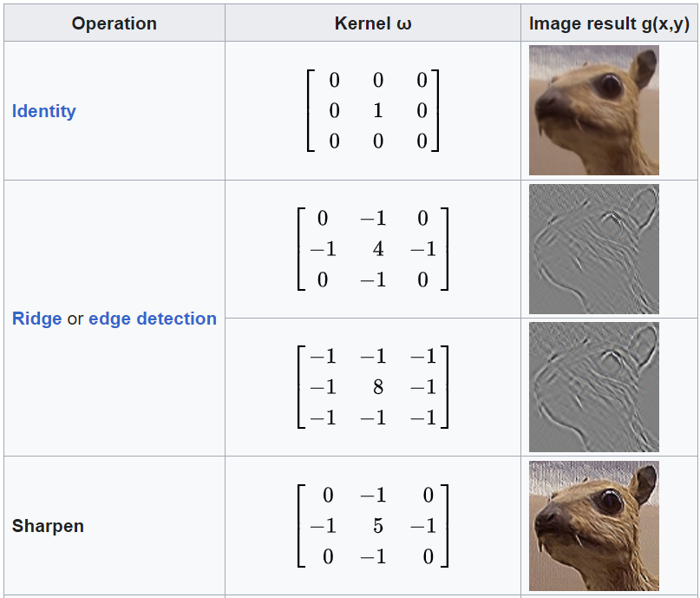
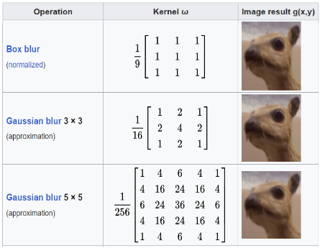
Convolutional kernels
https://en.wikipedia.org/wiki/Kernel_(image_processing)

Slide 56
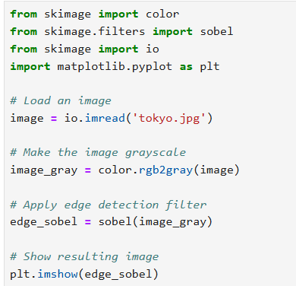
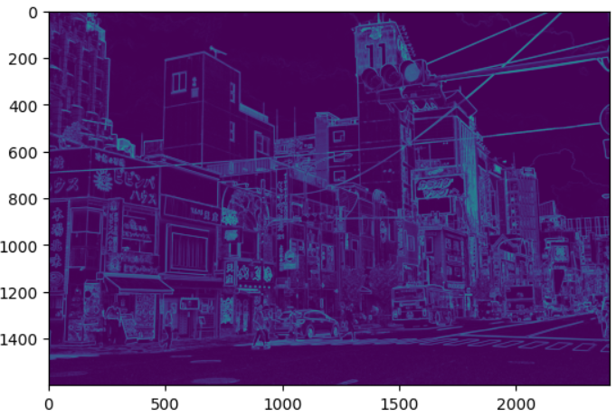
Edge detection
A common filter to detect edges is the Sobel filter.
It involves applying two 3 x 3 convolutional kernels to an image in grayscale.

Slide 57
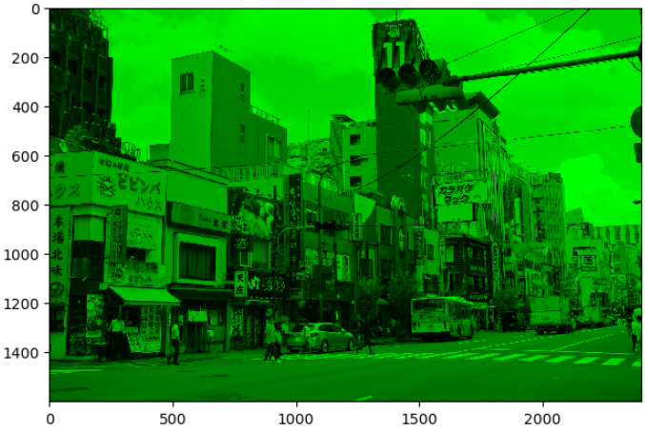
Color Manipulation
To extract individual color channels (red, green, blue) from a color image you just need to access the correct dimension of the image
from skimage import io, color
import numpy as np
# Load a color image
image = io.imread('tokyo.jpg')
# Extract color channels
image[:, :, 0] = 0 # Set red channel to 0
image[:, :, 2] = 0 # Set blue channel to 0
# Display the extracted color channels
plt.imshow(image)

Slide 58
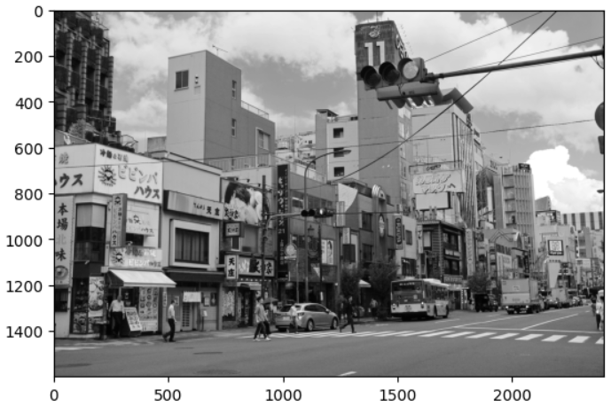
Color Manipulation
It is also possible to evaluate the amount of a color contained in the image in a gray scale.
from skimage import io, color
# Load a color image
image = io.imread('tokyo.jpg')
# Extract red color channel
red_channel = image[:, :, 0] # Red channel
# Display the extracted color channels
plt.imshow(red_channel, cmap='gray')

Slide 59
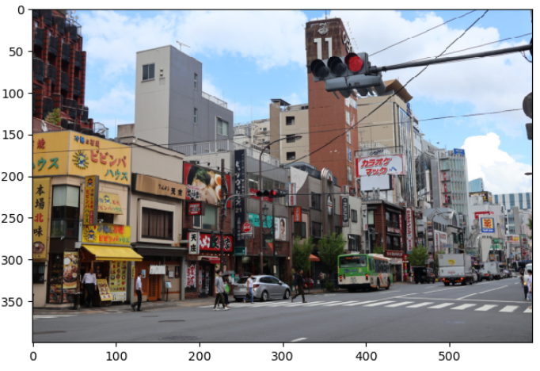
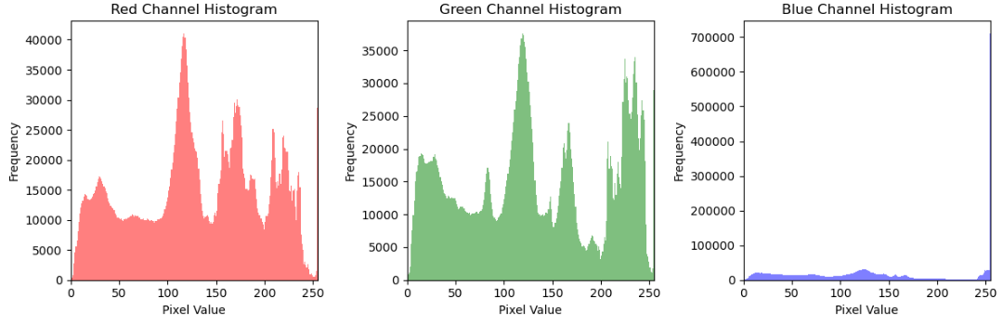
Color histograms
Another useful way to visualise color frequency is by using histograms.

Slide 60
Color histograms
Another useful way to visualise color frequency is by using histograms.
Why this number of bins?

Slide 61
Color histograms
Another useful way to visualise color frequency is by using histograms.
What happened here?

Slide 62
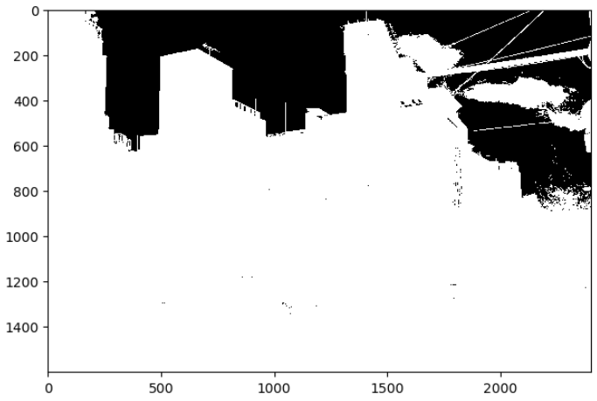
Thresholding
We can check where the high intensity blue pixels are located by applying a threshold.
Basically, we need to filter all the values > 250 in the blue channel.
from skimage import io
import matplotlib.pyplot as plt
# Load a color image
image = io.imread('tokyo.jpg')
blue_channel = image[:, :, 2]
mask_lower_pixel_values = blue_channel < 250
mask_higher_pixel_values = blue_channel >= 250
blue_channel[mask_lower_pixel_values] = 255
blue_channel[mask_higher_pixel_values] = 0
plt.imshow(blue_channel, cmap='gray')

Slide 63
Task 6
Using the red cat image (https://i.ibb.co/h041g0p/Red-Cat-8727.jpg) try to define a threshold value and highlight its background.
Hint: change the image to grayscale and plot its histogram using the following functions:
image_gray = rgb2gray(image)
plt.hist(image_gray.ravel(), bins=256)
Solution in the next slide...

Slide 64
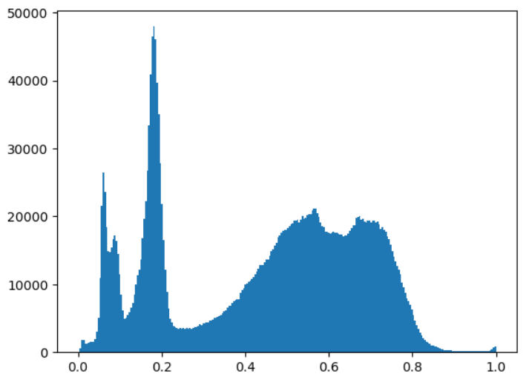
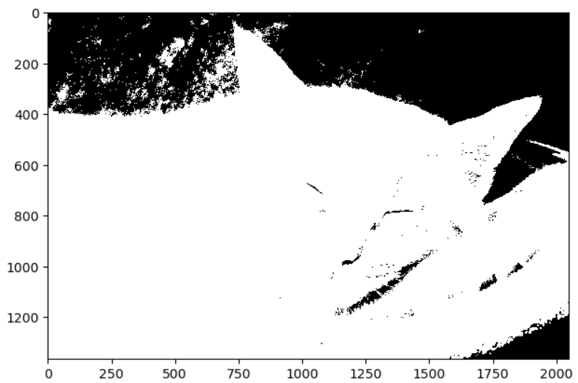
Task 6
from skimage import io
import matplotlib.pyplot as plt
from skimage.color import rgb2gray
import numpy as np
# Load a color image
image = io.imread('https://i.ibb.co/h041g0p/Red-Cat-8727.jpg')
# Make the image grayscale using rgb2gray
image_gray = rgb2gray(image)
mask_lower_pixel_values = image_gray < 0.2
mask_higher_pixel_values = image_gray >= 0.2
#print(mask)
image_gray[mask_lower_pixel_values] = 0
image_gray[mask_higher_pixel_values] = 1
plt.imshow(image_gray, cmap='gray')

Slide 65
Task 6
from skimage import io
import matplotlib.pyplot as plt
from skimage.color import rgb2gray
import numpy as np
# Load a color image
image = io.imread('https://i.ibb.co/h041g0p/Red-Cat-8727.jpg')
# Make the image grayscale using rgb2gray
image_gray = rgb2gray(image)
mask_lower_pixel_values = image_gray < 0.2
mask_higher_pixel_values = image_gray >= 0.2
#print(mask)
image_gray[mask_lower_pixel_values] = 0
image_gray[mask_higher_pixel_values] = 1
plt.imshow(image_gray, cmap='gray')
Is this the optimal value?

Slide 66
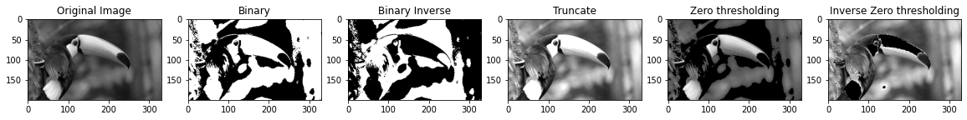
Thresholding
It is not always obvious which threshold value needs to be applied.
There are several thresholding methods with different approaches: binary thresholding, local threshold, variance minimisation, etc.
The choice of the thresholding method depends on the characteristics of the image and the specific task.
Experimentation is often necessary to find the most suitable method for a particular application.

Slide 67


Thresholding
Example of binary threshold with Otsu’s method (good to separate regions of interest from the background in a grayscale image)
# Import the otsu threshold function
from skimage.filters import threshold_otsu
from skimage.color import rgb2gray
from skimage import io
# Load a color image
image = io.imread('tokyo.jpg')
# Make the image grayscale using rgb2gray
image_gray = rgb2gray(image)
# Obtain the optimal threshold value with otsu
thresh = threshold_otsu(image_gray)
# Apply thresholding to the image
binary = image_gray > thresh
# Show the image
io.imshow(binary)

Slide 68


Image segmentation
Thresholding is one form of image segmentation.
Generally, image segmentation involves partitioning an image into meaningful, homogeneous regions or objects.
Other applications include:
Contour: Contour detection is often used for object recognition and shape analysis.
Feature Extraction: Capturing relevant information such as edges, corners, or texture patterns to be used in more advanced segmentation techniques.
Morphological Operations: modify the shape and structure of regions in the image for tasks like noise reduction or region enhancement.

Slide 69
Example
from skimage.segmentation import slic
from skimage.color import label2rgb
from skimage import io
import numpy as np
# Load a color image
image = io.imread('tokyo.jpg')
# Obtain the segmentation with 1600 regions
segments = slic(image, n_segments=1600)
# Put segments on top of original image to compare.
# The color of each segment is the average color of pixels in that segment
segmented_image = label2rgb(segments, image, kind="avg")
plt.imshow(segmented_image)

Slide 70
Example
from skimage.segmentation import slic
from skimage.color import label2rgb
from skimage import io
import numpy as np
# Load a color image
image = io.imread('tokyo.jpg')
# Obtain the segmentation with 1600 regions
segments = slic(image, n_segments=1600)
# Put segments on top of original image to compare.
# The color of each segment is the average color of pixels in that segment
segmented_image = label2rgb(segments, image, kind="avg")
plt.imshow(segmented_image)
SLIC (Simple Linear Iterative Clustering) algorithm, which combines k-means clustering to return coherent regions in the image that are similar in color and texture.

Slide 71
Task 7
Modify the previous code and observe the results for different numbers of segments.
Remove the kind parameter from label2rgb. What happens to the output image?
Solution in the next slide...

Slide 72





Task 7
100 segments
1000 segments
100 segments, no avg
500 segments
5000 segments

Slide 73
R options
Magick: supports various image formats and allows resizing, cropping, rotating, applying filters, and adding text or graphics to the image.
Imager: wide range of functions for image manipulation, filtering, morphological operations, and feature extraction.
OpenImageR: reading, writing, and basic processing of images.
And many others: EBImage, imagerExtra, pavo, etc.

Slide 74
Summary
Digital image definition
Image file types
Loading and displaying images
Basic image manipulation operations
Definition of filtering and convolution
Image segmentation
List of R options

Slide 75
References
Rafael C. Gonzalez, Richard E. Woods., Digital image processing, Pearson, 2017
Image Processing in Python (Datacamp)
https://de.mathworks.com/discovery/image-enhancement.html
https://pub.towardsai.net/gaussian-blurring-a-gentle-introduction-e34aca1d9bbd
https://en.wikipedia.org/wiki/Kernel_(image_processing)
https://www.analyticsvidhya.com/blog/2022/07/a-brief-study-of-image-thresholding-algorithms/

Slide 76
Lab
Please work on the assignment in week 11 folder. You will be required to submit it before week 12.

Slide 77
Questions?

